Slide 1
INTRODUCTION GUARDIAN360

Slide 2
Jan Martijn Broekhof MBA
Founder and MD
IT Entrepreneur since 2001
Guardian360 Lighthouse Product Owner
I strongly believe it’s unfair that organizations invested heavily in IT and have to deal with online criminals
JM.Broekhof@Guardian360.net
+31624565502

Slide 3
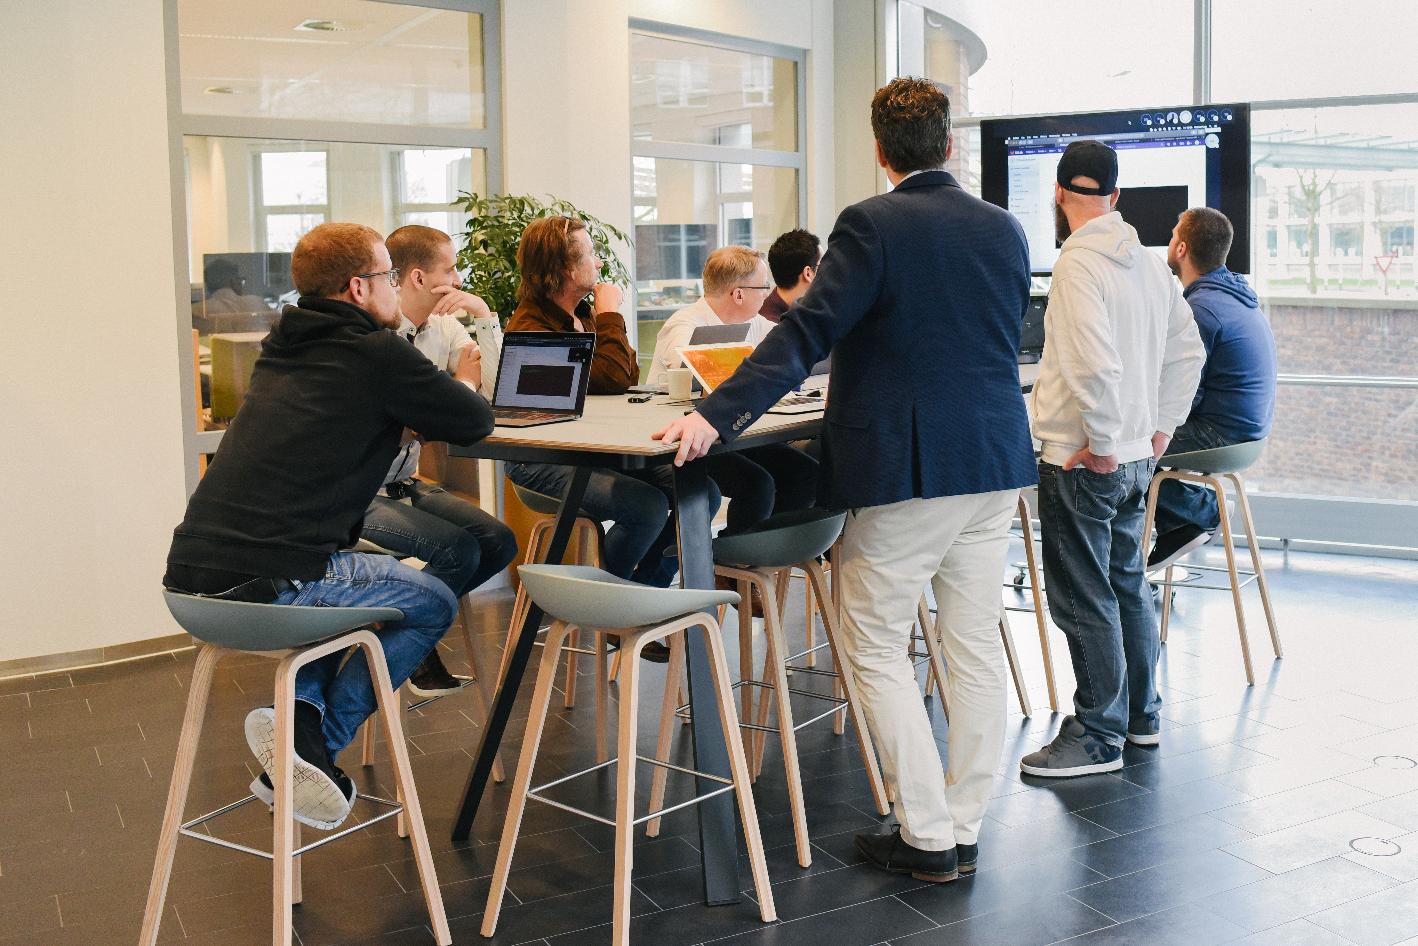

Slide 4
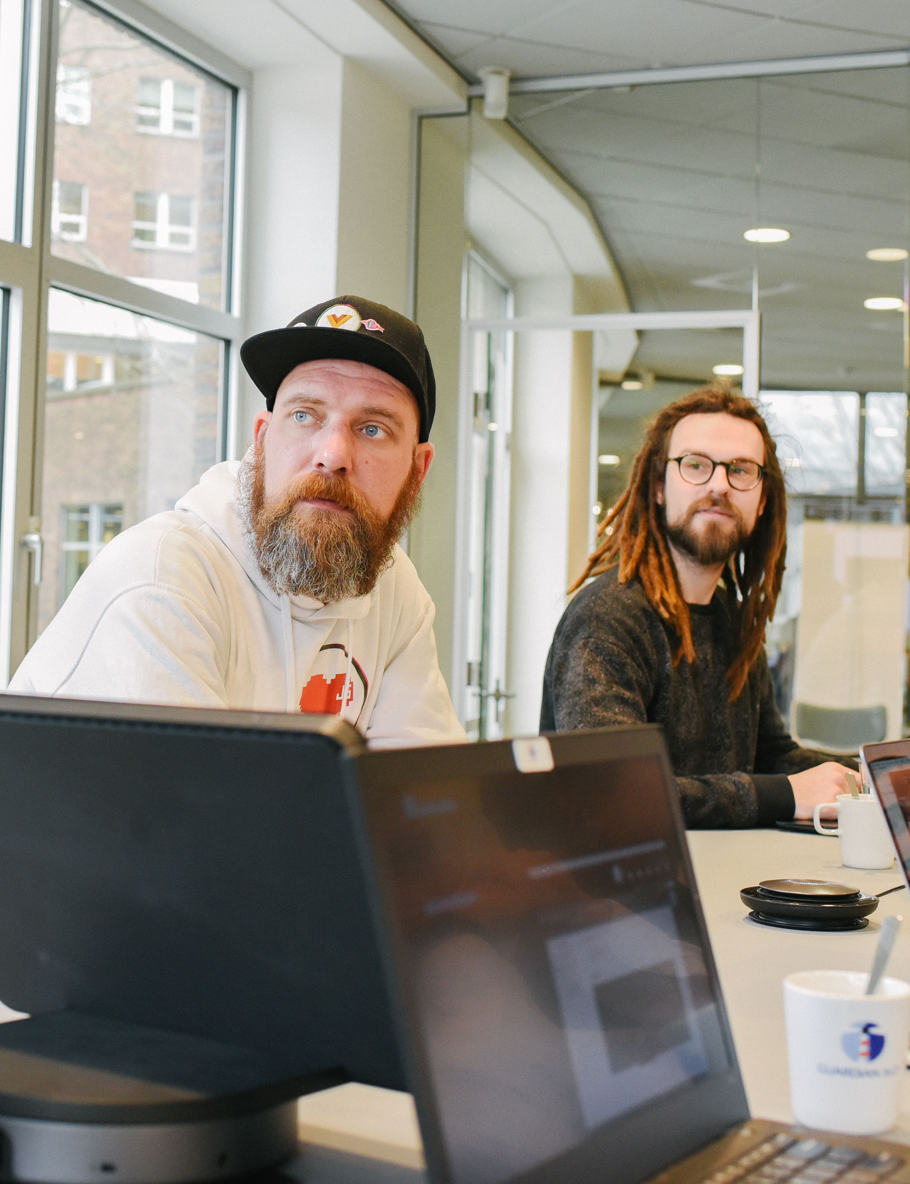
Company background
Netherlands based ISV
Partner only strategy
Privately held, founded in 2015
10 staff
ISO27001 certified
We thrive to make security a commodity

Slide 5
Information security related to risk management
“Holy Trinity” within information security:
People
Process
Technology
Guardian360 adds another trinity:
Prevent
Detect
Remediate

Slide 6
Guardian360 Subscription Services (MRR)
Continuous scanning and monitoring:
Office networks;
Web applications;
IOT/SCADA devices.
Compliance module, automated audits on:
GDPR Recommendations
ISO27001 Compliance
OWASP Recommendations
PCI-DSS Compliance
And 10 other norms/regulations/ standards
Continuous detection of hackers
Pricing is based on:
# IP’s and/or
# Staff and/or
# URL’s and/or
# Norms/regulations/standards

Slide 7
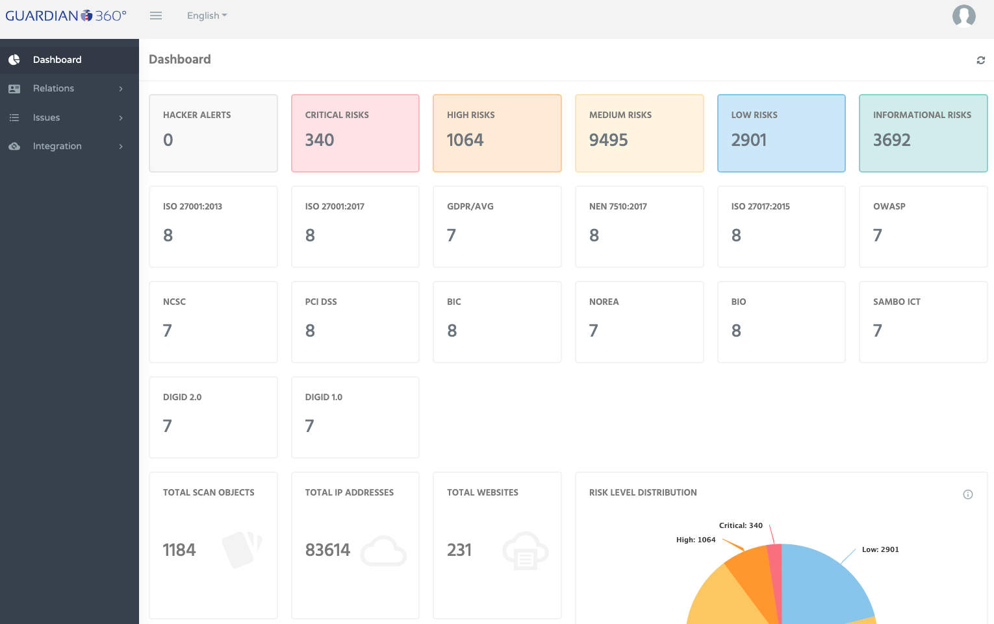

Slide 8
Technology stack Guardian360 Lighthouse Platform
Combination of commercial, open source and inhouse developed tools
We aim to have as less staff as possible, so we automate everything:
Test driven development
Continuous code quality review
Code linting
Hardening and security testing
We adopted docker, gRPC, python 3, CICD and other SecDevOps tools and best practices
Central platform is currently hosted on Guardian360 infrastructure in The Netherlands, hosting a copy in the region will be possible in the near future

Slide 9
Competition and USP’s
No competition (we know of) for the complete offering
Competition in various fields: vulnerability scanning, detection and phishing
USP’s Guardian360:
Multiple scanners;
Continuous subscription services;
Single pane of glass;
Partner only strategy;
Offering for SME companies.

Slide 11
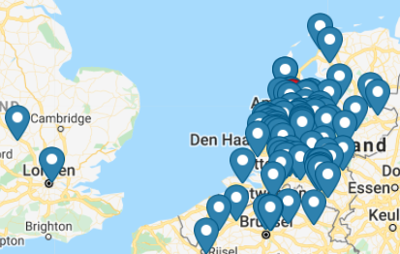
Geographical coverage
Approximately 150 partners in:
Belgium
Colombia
Curaçao
Germany
Morocco
Saudi Arabia
The Netherlands
Turkey
United Kingdom
End customers in approximately 150 countries

Slide 12
Partner only?
Building a secure, scalable and stable security platform is hard
We don’t want end customers to blame their IT services providers for bad security
System and network engineers are the ones who improve security, clients should be ’in control’ of their business risks
We strongly believe a partner can consult its clients better then we do
And of course, upselling is much easier for a partner ;-)

Slide 13
Main benefits for partners
Easy to sell, easy to onboard
No security specialist needed
Increase MRR
Create new contact moment with clients on a monthly basis
Partnership possibility without being chased by a sales guy
Prove to end customers that your security is in order
Comply with GDPR, ISO27001, OWASP, PCI-DSS And 10 other norms/regulations/standards

Slide 14
Demo
https://lighthouse.guardian360.nl

Slide 15
Take-aways
Guardian360 allows IT-services providers to offer security services to clients, without the need of security specialists and a 24/7 operating SOC
Partner only, we generate leads and orders for partners
SME offerings (as well as large enterprise offerings)
Security is a continuous process, we offer subscription-based services only
Increase MRR and up- and cross sell other services
14 Days try before you buy

Slide 16
c
Guardian360
Orteliuslaan 1000
3528 BD Utrecht
The Netherlands
P.O. Box 2655
3000 CR Rotterdam
+31(0)88 - 255 15 00
Guardian360.net
info@guardian360.net
Guardian360 bv
@Guardian360NET

