Slide 1
9-plane model workshop

Slide 2
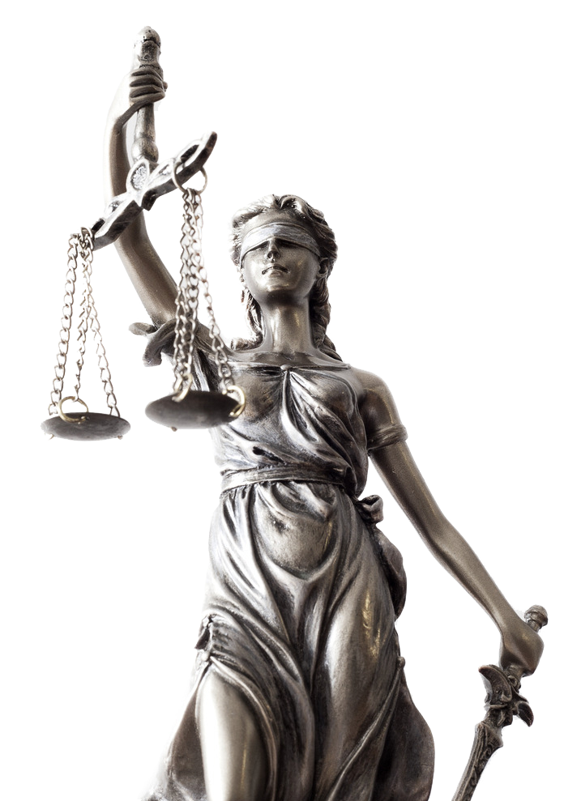
Our goal is to increase justice on the digital infrastructure
“We strongly believe it’s unfair people and organizations invested heavily in IT and aren’t able to capitalize on it without being afraid of security incidents.”

Slide 3
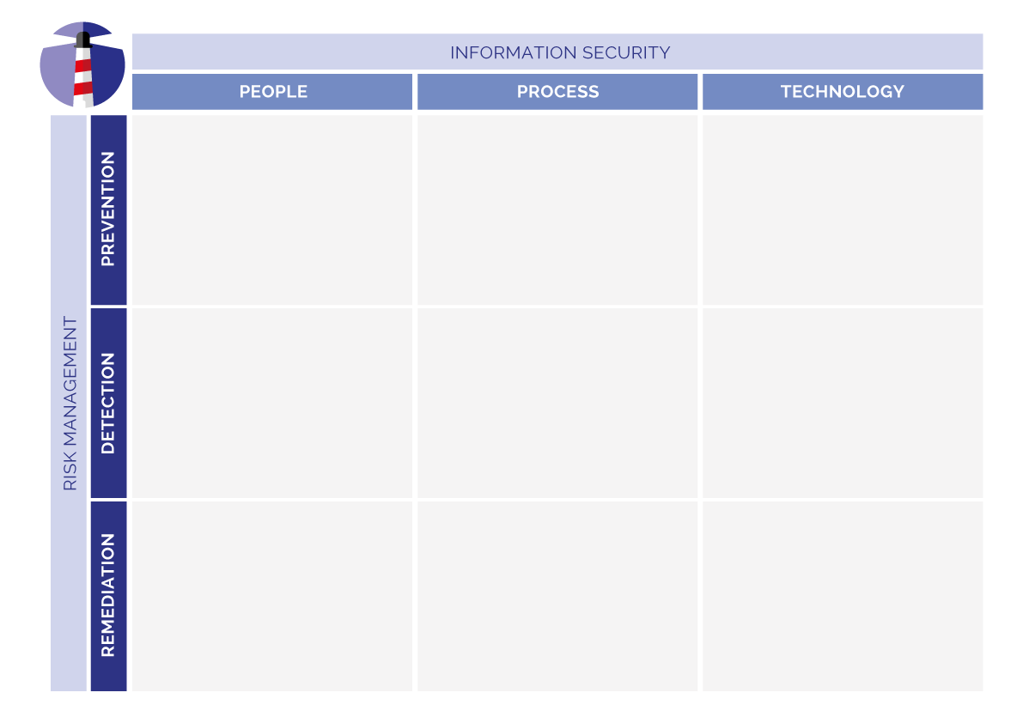
Table of contents
Welcome!
Origin
Information security
Risk management
Start using the 9-plane model

Slide 4
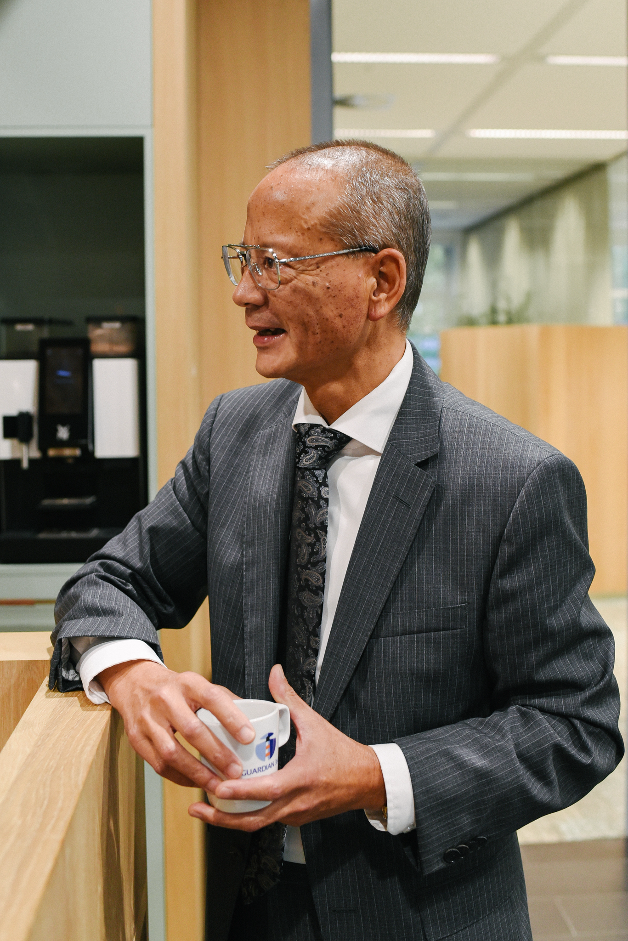
Welcome!
Round of introductions, get to know each other
Notes:
The meaning of this round of introductions is for the participants to get to know each other so they are more comfortable to share their vision and ask questions
As a hostes/host, try to make this round interactive and personal by introducing everyone with a personal touch

Slide 5
Origin
Developed by Guardian360
Information security is simply part of risk management
Organisations need to become “in control”
Management must invest wisely
Measures have to match a business case
Notes:
Jan Martijn Broekhof of Guardian360 developed the 9-plane model during his MBA dissertation
A lot of vendors are trying to sell information security services and products. However, often these do not solve the organisation's real problem and create a false sense of security
One of the reasons vendors succeed acting this way is because they confuse clients and present information security more difficult and scary than it actually is
The 9-plane model supports management of organisations in determining what measures are in place, where additional measures are needed and where the measures are already sufficient. Based on the risk apetite and business case of the organisation.
This results in management teams to become in control and quickly determine if a vendor is offering the correct solution to their problems

Slide 6
Information security
People
The human resources available at the firm’s disposal.
Process Resembles the steps or actions that combine to produce a particular goal.
Technology Provides the tools that the people can use to implement the process.
Notes:
The people, process, technology framework has been around since the early 1960s. Most businesses used it to improve the operational efficiency of their employees and tools. In the late 1990s, it was popularized in the infosec world by Bruce Schneier. These days, most software companies use the framework for information technology management.
The people are the ones who do the tasks described in the process, sometimes by leveraging the technology. Most of the times the people are on the payroll of an organization but due to attention to delivery chains more and more organisations are including staff of suppliers and clients as well
The process in the framework mostly defines the ”how” aspect. How will we achieve the desired result? How do we utilize the people and technology to solve the business problem? Processes are repeatable actions that theoretically produce the same result independent of who performs them.
It also helps automate some parts of the process. Ideally, the latest and fastest technology creates the most impact. It’s very tempting to get attracted to shiny new tools. However, organizations need to make sure that the technology fits into the organization.
Source: https://www.plutora.com/blog/people-process-technology-ppt-framework-explained

Slide 7
Notes:
The challenge is to balance attention and investments the correct way
https://www.lifewire.com/thmb/538K4o_3_KDmQmdB-kvpyUsYDOc=/768x0/filters:no_upscale():max_bytes(150000):strip_icc()/rocks-balancing-on-driftwood--sea-in-background-153081592-591bbc3f5f9b58f4c0b7bb16.jpg

Slide 8
Risk management
Prevention Measures to avoid bad things from happening as much as possible
Detect
Measures to detect incidents quickly to allow organizations to act and lower the (financial) damages
Remediate
Measures taken to allow organizations to return to the desired state
Notes:
Risk management is the identification, evaluation, and prioritization of risks followed by coordinated and economical application of resources to minimize, monitor, and control the probability or impact of unfortunate events or to maximize the realization of opportunities.
Source: https://en.wikipedia.org/wiki/Risk_management
Guardian360 translated this to Prevention, Detection and Remediation

Slide 9
Staff onboarding and exit procedure
Firewall
Awareness training
Phishing simulations
Compliance audits
Intrusion detection
Incident response
PDCA-cycle
Disaster recovery

Slide 10
Before filling out the 9-plane model, ask yourself
What are the most important information streams in my organization?
What are the most important information systems in my organization?
What is the maximum outage time we’re willing to accept?
What measures are already taken?
Which customers, partners and/or suppliers depend on your information systems?
How do you ensure your employees are aware of the importance of proper information security?
Are you aware that information security goes far beyond IT? People and processes are equally important.
Notes:
We want to prevent clients from simply buying new and shiny solutions.
Only invest in what’s worth investing.

Slide 11
Good luck!
And learn from each other
Notes:
Ideally, participants break-up in groups of 3-4 people to discuss with and learn from each other

Slide 12
Guardian360
Schouwburgplein 30-34
3012 CL Rotterdam
Orteliuslaan 1000
3528 BD Utrecht
The Netherlands
P.O. Box 2655
3000 CR Rotterdam
+31(0)88 - 255 15 00
Guardian360.net
info@guardian360.net
c

